Slide 1
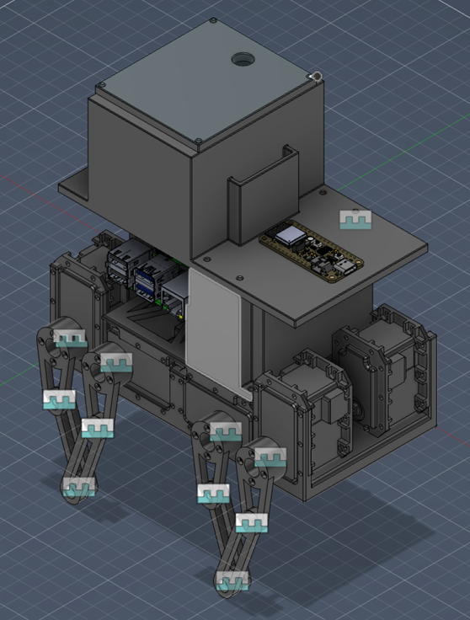
GreenBot
Quadruped Greenhouse Humidity Monitoring & Misting Robot
Team Members:
Bader AlKhawashki, Arunima Basu, Fritz Kuermayr, Salvador Gonzalez
The goal of this project is to create a simple and affordable greenhouse automation system for small and medium-sized farms. GreenBot will be designed to help farmers remotely monitor and control greenhouse conditions when they are not physically present, offering an easier alternative to expensive and overly complicated existing systems.

Slide 2
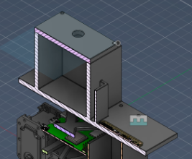
Upper System: Environmental Monitoring + Misting
Function - Critical parts
Humidity sensor
ESP 32 microcontroller
Mister pump + nozzle
Tank and Platform
Cable/LED
Manufacturing
3D print tank platform and sensor mounts
Purchase off-the-shelf sensor, ESP32, mister, and cables
Assemble using fasteners and wire routing
Nozzle for mist
Water Tank
ESP 32
Materials considered
3D-printed : PLA/PETG
Nozzle/pump housing: plastic + metal internal pump parts
Sensor housing: lightweight printed enclosure
Notes:
The ESP 32 receives humidity data from the sensor and sends a control signal to a relay or MOSFET, which switches the misting on or off using external power.

Slide 3
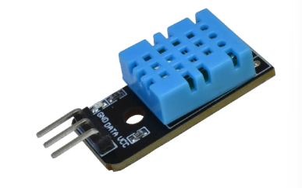
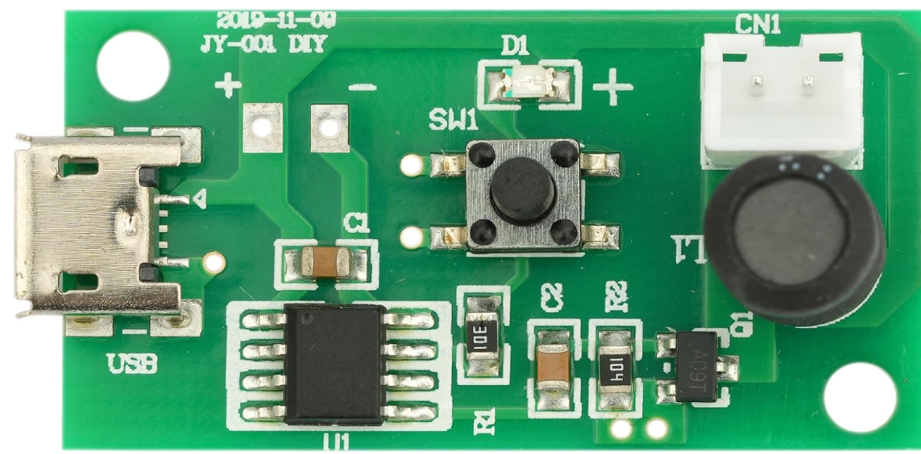
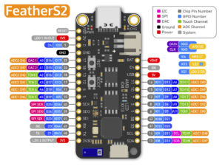
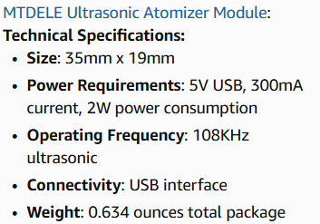
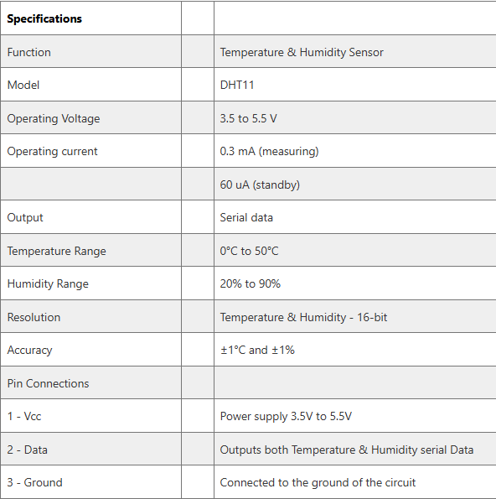
Temperature and Humidity
Sensor Module Data Sheet
Data Sheets

Slide 4
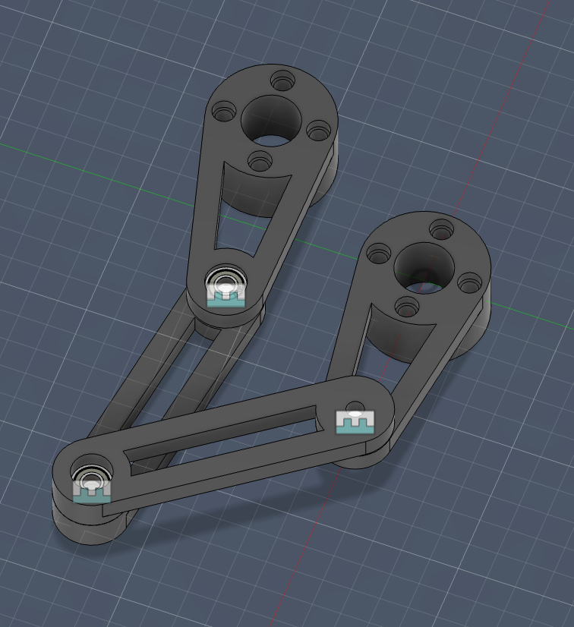
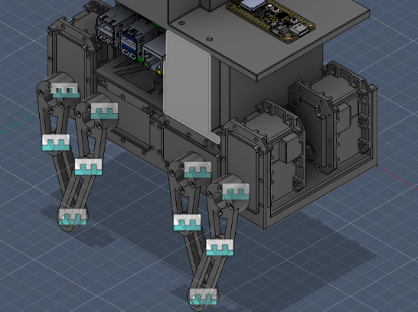
Lower System: Walking/Support Mechanism
Raspberry Pi
2 legs each side
Function - Critical parts
4 legs
Ball bearings(press fit)
Dynamixel RX-24F actuators
Chassis
Distance holders/mounts
Materials considered
Legs and chassis: 3D-printed PLA, PETG
Bearings: metal
Actuator housings: bought
Fasteners/spacers: metal hardware
Manufacturing
3D print leg links, chassis, holders, and mounts
Press-fit bearings into printed joints
Assemble chassis with spacers and screws

Slide 5
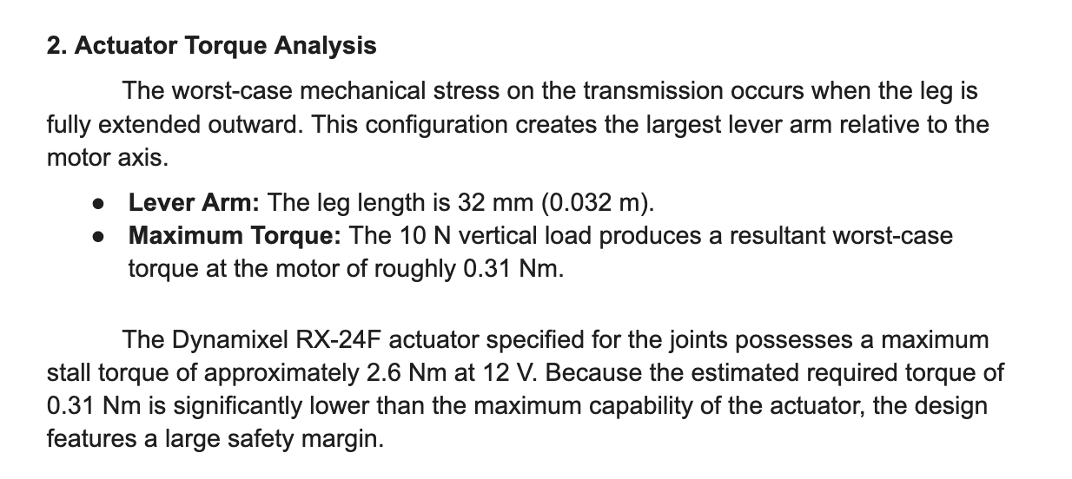
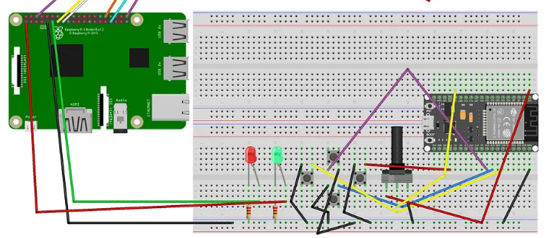
How Pi 4 and ESP 32 will communicate with each other

Slide 6
3 Questions
How can we make sure that chassis would support the water tank + electronics + battery?
What improvements we need to incorporate in the design to provide enough torque for full loaded movement?
Suggestions for printed material best for strength and lightweight.

